Slide 1
PeopleSoft Automation
Participants : Sameer Khanna, Kathy Kha, Sidhant Dayal, Vineet Wadwekar, Shivangi Tyagi, Venkat P, Karthik R, Sourav Mitra, Shyam Jha, Ramesh N, Bhanu M and Jatin P.

Slide 2
Automation Status as on 03rd Mar 2021
Focus Area | Regression Test Cases |  | Progression Automation – Identified in Sprint 6 |  |  |  | Comment
 | Total | Verified / Working | Total Tests | Reusable automated Tests | Automatable | Automated
HCM | 315 | 315 | 42 | 12* | 3 | 0** | * Existing 12 automated test cases were reused. ** We are awaiting business conformation for the go ahead, once get confirmation 3 scripts will be automated.
GL | 424 | 424 | 9 | 0 | 4 | 4 | 5 Manual tests were created for stories related to BAU changes with SIT / file transfers and Excel to CI
AM | 238 | 238 | 22 | 0 | 19 | 12 | Upgrade tests
LA | 78 | 78 | 23 | 0 | 20 | 16 | Upgrade tests
AP | 419 | 419 | 9 | 4 | 5 | 5 | 5 test cases are automated related to sanction screening adhoc template & Netreveal report task.
Purchasing | 95 | 95 | 6 | 2 | 2 | 2 | PO email dispatch Dispatch for India BU changes got automated
E-Proc | 44 | 44 | 6 | 0 | 6 | 2 | Requisition Approval workflow changes are yet to automated post build completion with new design changes.Agreed to move to next PI.

Slide 3
Execution Status as on 03rd Mar 2021
Focus Area |  | Regression Test Cases |  |  |  |  |  |  |  | Comment
 | Planned End Date | Automated | Manual | Total Regression test cases | Executed till 03rd Mar | Pass | Fail | Not Executed | Defect Resolved | ETA
GL - Cycle 1 | 25 Dec 2020 | 422 | 34 | 456 | 451 | 451 | 0 | 5 | 42 out of 42 | Completed except for 5 Manual Test cases related archival are deferred to Cycle 3 (ETA 11th^{h} Apr) and 1 failed test case.
GL – Cycle 2 | 11 Apr 2021 | 422 | 34 | 456 | 220 | 209 | 11 | 236 | 33 out of 39
AM –Cycle 1 | 25 Dec 2020 | 238 | 18 | 256 | 256 | 256 | 0 | 0 | 3 out of 3 | Completed.
AM-Cycle 2 | 11 Apr 2021 | 238 | 18 | 256 | 256 | 238 | 18 | 0 | 9 out of 11

Slide 4
Execution Status as on 03rd March 2021
Focus Area |  | Regression Test Cases |  |  |  |  |  |  |  | Comment
 | Planned End Date | Automated | Manual | Total Regression test cases | Executed till 03rd March | Pass | Fail | Not Executed | Defect Resolved | ETA
LA –Cycle 1 | 25 Dec 2020 | 78 | 0 | 78 | 78 | 78 | 0 | 0 | 0 | Completed.
LA- Cycle 2 | 11 Apr 2021 | 112 | 0 | 112 | 82 | 65 | 17 | 30 | 7 out of 7
AP-Cycle1 |  | 419 | 26 | 445 | 445 | 445 | 0 | 0 | 1 out of 1 | Completed
AP-Cycle2 | 11 Apr 2021 | 423 | 26 | 449 | 205 | 191 | 14 | 218 | 0 | Identified the issues for the failures and expecting to run with updated data.

Slide 5
Execution Status as on 03rd Mar 2021
Focus Area |  | Regression Test Cases |  |  |  |  |  |  |  | Comment
 | Planned End Date | Automated | Manual | Total Regression test cases | Executed till 03 Mar 2021 | Pass | Fail | Not Executed | Defect Resolved | ETA
Purchasing-Cycle1 |  | 95 | 0 | 95 | 95 | 95 | 0 | 0 | 0 | Completed
Purchsing-Cycle2 | 5 Mar 2021 | 95 | 0 | 95 | 95 | 90 | 5 | 0 | 0
E-Proc-Cycle1 |  | 44 | 0 | 44 | 44 | 44 | 0 | 0 | 0 | Completed
E-Proc-Cycle2 | 11 Apr 2021 | 44 | 0 | 44 | 44 | 44 | 0 | 0 | 0 | Completed(Note:Requisition approval workflow needs to considered for next run with updated design-changes)

Slide 6
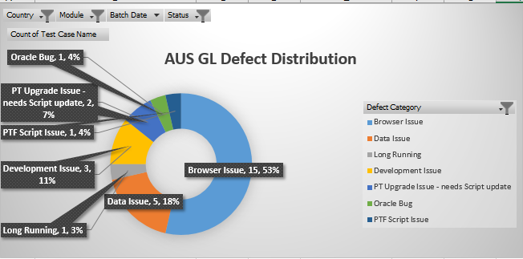
Defect Distribution

Slide 7
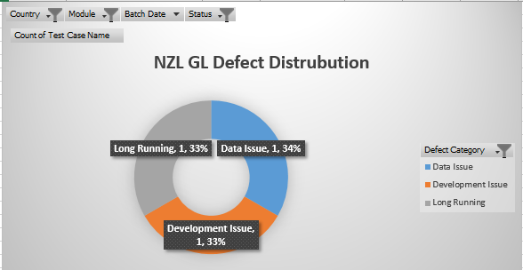
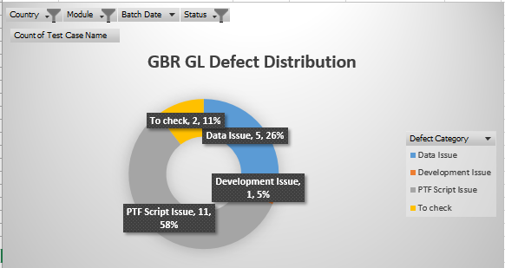

Slide 8
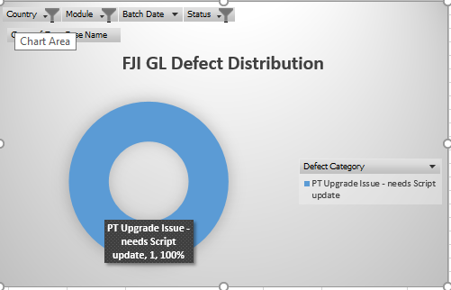
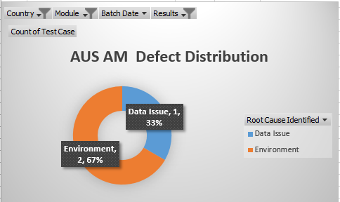
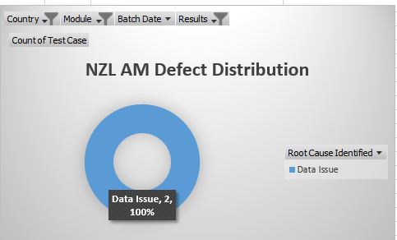

Slide 9
Bi weekly Execution Tracker
Country | Module | Category | Coverage | Test Cycle 2 | Activity | Planned Start Date | Planned End Date | Actual Start Date | Actual End Date
AUS | AM | Automation | Regression | Cycle 2 | Data Input | 17-Feb-21 | 17-Feb-21 | 16-Feb-21 | 16-Feb-21
 |  |  |  |  | Batch | 17-Feb-21 | 18-Feb-21 | 16-Feb-21 | 17-Feb-21
 |  |  |  |  | Verification | 18-Feb-21 | 19-Feb-21 | 17-Feb-21 | 18-Feb-21
 |  |  |  |  | Re-run | 19-Feb-21 | 19-Feb-21 | 18-Feb-21 | 18-Feb-21
NZL | AM | Automation | Regression | Cycle 2 | Data Input | 22-Feb-21 | 22-Feb-21 | 18-Feb-21 | 19-Feb-21
 |  |  |  |  | Batch | 22-Feb-21 | 23-Feb-21 | 19-Feb-21 | 19-Feb-21
 |  |  |  |  | Verification | 23-Feb-21 | 24-Feb-21 | 22-Feb-21 | 22-Feb-21
 |  |  |  |  | Re-run | 24-Feb-21 | 24-Feb-21 | 22-Feb-21 | 22-Feb-21
GBR | AM | Automation | Regression | Cycle 2 | Data Input | 25-Feb-21 | 25-Feb-21 | 23-Feb-21 | 23-Feb-21
 |  |  |  |  | Batch | 25-Feb-21 | 26-Feb-21 | 23-Feb-21 | 23-Feb-21
 |  |  |  |  | Verification | 26-Feb-21 | 1-Mar-21 | 23-Feb-21 | 23-Feb-21
 |  |  |  |  | Re-run | 1-Mar-21 | 1-Mar-21 | 23-Feb-21 | 23-Feb-21

Slide 10
Execution Tracker – contd …
Country | Module | Category | Coverage | Test Cycle 2 | Activity | Planned Start Date | Planned End Date | Actual Start Date | Actual End Date
FJI | AM | Automation | Regression | Cycle 2 | Data Input | 2-Mar-21 | 2-Mar-21 | 24-Feb-21 | 24-Feb-21
 |  |  |  |  | Batch | 2-Mar-21 | 3-Mar-21 | 24-Feb-21 | 24-Feb-21
 |  |  |  |  | Verification | 3-Mar-21 | 4-Mar-21 | 25-Feb-21 | 25-Feb-21
 |  |  |  |  | Re-run | 4-Mar-21 | 4-Mar-21 | - | -
AUS | GL | Automation | Regression | Cycle 2 | Data Input | 18-Feb-21 | 19-Feb-21 | 17-Feb-21 | 18-Feb-21
 |  |  |  |  | Batch | 22-Feb-21 | 22-Feb-21 | 19-Feb-21 | 20-Feb-21
 |  |  |  |  | Verification | 22-Feb-21 | 23-Feb-21 | 22-Feb-21 | 22-feb-21
 |  |  |  |  | Re-run | 24-Feb-21 | 24-Feb-21 | - | -
NZL | GL | Automation | Regression | Cycle 2 | Data Input | 25-Feb-21 | 26-Feb-21 | 23-Feb-21 | 23-Feb-21
 |  |  |  |  | Batch | 26-Feb-21 | 1-Mar-21 | 24-Feb-21 | 24-Feb-21
 |  |  |  |  | Verification | 2-Mar-21 | 2-Mar-21 | 24-Feb-21 | 24-Feb-21
 |  |  |  |  | Re-run | 3-Mar-21 | 3-Mar-21 | 24-Feb-21 | 24-Feb-21

Slide 11
Execution Tracker – contd …
Country | Module | Category | Coverage | Test Cycle 2 | Activity | Planned Start Date | Planned End Date | Actual Start Date | Actual End Date
FJI | GL | Automation | Regression | Cycle 2 | Data Input | 3-Mar-21 | 3-Mar-21 | 25-Feb-21 | 25-Feb-21
 |  |  |  |  | Batch | 4-Mar-21 | 4-Mar-21 | 25-Feb-21 | 25-Feb-21
 |  |  |  |  | Verification | 4-Mar-21 | 4-Mar-21 | 25-Feb-21 | 25-Feb-21
LAOS | LA | Automation | Regression | Cycle 2 | Data Input | 15-Feb-21 | 15-Feb-21 | 15-Feb-21 | 15-Feb-21
 |  |  |  |  | Batch | 16-Feb-21 | 16-Feb-21 | 16-Feb-21 | 16-Feb-21
 |  |  |  |  | Verification | 17-Feb-21 | 18-Feb-21 | 17-Feb-21 | 18-Feb-21
 |  |  |  |  | Re-run | 19-Feb-21 | 22-Feb-21 | 19-Feb-21 | 22-Feb-21
HKG | LA | Automation | Regression | Cycle 2 | Data Input | 22-Feb-21 | 22-Feb-21 | 22-Feb-21 | 22-Feb-21
 |  |  |  |  | Batch | 23-Feb-21 | 24-Feb-21 | 23-Feb-21 | 24-Feb-21
 |  |  |  |  | Verification | 24-Feb-21 | 25-Feb-21 | 24-Feb-21 | 25-Feb-21
 |  |  |  |  | Re-run | 26-Feb-21 | 26-Feb-21 | 26-Feb-21 | 26-Feb-21

Slide 12
Projection for next 2 weeks
Country | Module | Category | Coverage | Test Cycle 2 | Activity | Planned Start Date | Planned End Date | Actual Start Date | Actual End Date
SGP | AM | Automation | Regression | Cycle 2 | Data Input | 5-Mar-21 | 5-Mar-21 | 26-Feb-21 | 26-Feb-21
 |  |  |  |  | Batch | 8-Mar-21 | 8-Mar-21 | 26-Feb-21 | 26-Feb-21
 |  |  |  |  | Verification | 9-Mar-21 | 9-Mar-21 | 26-Feb-21 | 01-Mar-21
 |  |  |  |  | Re-run | 9-Mar-21 | 9-Mar-21 | - | -
HKG | AM | Automation | Regression | Cycle 2 | Data Input | 10-Mar-21 | 10-Mar-21 | 01-Mar-21 | 01-Mar-21
 |  |  |  |  | Batch | 10-Mar-21 | 11-Mar-21 | 02-Mar-21 | 02-Mar-21
 |  |  |  |  | Verification | 12-Mar-21 | 12-Mar-21 | 02-Mar-21 | 02-Mar-21
 |  |  |  |  | Re-run | 12-Mar-21 | 12-Mar-21 | - | -
CHN | AM | Automation | Regression | Cycle 2 | Data Input | 15-Mar-21 | 15-Mar-21 | 03-Mar-21
 |  |  |  |  | Batch | 15-Mar-21 | 16-Mar-21
 |  |  |  |  | Verification | 17-Mar-21 | 18-Mar-21
 |  |  |  |  | Re-run | 19-Mar-21 | 19-Mar-21

Slide 13
Projection for next 2 weeks..contd
Country | Module | Category | Coverage | Test Cycle 2 | Activity | Planned Start Date | Planned End Date | Actual Start Date | Actual End Date
GBR | GL | Automation | Regression | Cycle 2 | Data Input | 5-Mar-21 | 5-Mar-21
 |  |  |  |  | Batch | 6-Mar-21 | 6-Mar-21
 |  |  |  |  | Verification | 7-Mar-21 | 8-Mar-21
 |  |  |  |  | Re-run | 8-Mar-21 | 8-Mar-21
SGP | GL | Automation | Regression | Cycle 2 | Data Input | 9-Mar-21 | 9-Mar-21
 |  |  |  |  | Batch | 10-Mar-21 | 10-Mar-21
 |  |  |  |  | Verification | 11-Mar-21 | 12-Mar-21
 |  |  |  |  | Re-run | 12-Mar-21 | 12-Mar-21
HKG | GL | Automation | Regression | Cycle 2 | Data Input | 15-Mar-21 | 15-Mar-21
 |  |  |  |  | Batch | 16-Mar-21 | 16-Mar-21
 |  |  |  |  | Verification | 17-Mar-21 | 17-Mar-21
 |  |  |  |  | Re-Run | 17-Mar-21 | 17-Mar-21

Slide 14
Projection for next 2 weeks..contd
Country | Module | Category | Coverage | Test Cycle 2 | Activity | Planned Start Date | Planned End Date | Actual Start Date | Actual End Date
CHN | GL | Automation | Regression | Cycle 2 | Data input | 17-Mar-21 | 18-Mar-21
 |  |  |  |  | Batch | 18-Mar-21 | 19-Mar-21
 |  |  |  |  | Verification | 22-Mar-21 | 22-Mar-21
 |  |  |  |  | Re-run | 22-Mar-21 | 22-Mar-21
SGP | LA | Automation | Regression | Cycle 2 | Data Input | 8-Mar-21 | 8-Mar-21
 |  |  |  |  | Batch | 8-Mar-21 | 9-Mar-21
 |  |  |  |  | Verification | 10-Mar-21 | 11-Mar-21
 |  |  |  |  | Re-run | 11-Mar-21 | 12-Mar-21
CHN | LA | Automation | Regression | Cycle 2 | Data Input | 12-Mar-21 | 12-Mar-21
 |  |  |  |  | Batch | 15-Mar-21 | 16-Mar-21
 |  |  |  |  | Verification | 17-Mar-21 | 17-Mar-21
 |  |  |  |  | Re-run | 17-Mar-21 | 17-Mar-21

Slide 15
Blocker & Environment issue - New
Sl No | Backlog / Issue | Raised On | Owner | Status | Aging | Comment
1 | INC3509864 -Balance Compare Load ANZ_BALC_LD is failing in PT 8.58 for files larger than 156 lines | 24-Feb-21 | Navneet | Open | 6 | Oracle SR # 3-25335007731 is opened
2 | INC3268563 – Long running Online Journal Edit in China | 14th Dec 21 | Kiran | Open | 59
3 | RITM1830269 - Identify the tablespace for APLARGE_GBL and APLARGE_NZL | 26th Feb 21 | Bhanu | Open | 5
4 | RITM1834750 - GBFUDEV1_Regular entry page issue | 01st Mar 21 | Bhanu | Open | 2
5 | INC3512818-PFT batch run is giving error | 03rd Mar 21 | Jatin | Closed | 1
6 | INC3492739 -HCMUSYS1 is down. | 25th Feb 21 | Jatin | Closed | 4
7 | RITM1838317 - increase tablespace size to 15 gb in APLARGE_GBL and APLARGE_NZL | 02nd Mar 21 | Bhanu | Closed | 1

Slide 16
Blocker & Environment issue - New
Sl No | Backlog / Issue | Raised On | Owner | Status | Aging | Comment
9 | INC3512809-Process in Queued Status in CNFUSYS1 | 03rd Feb 21 | Santosh | Closed | 1
10 | INC3511503 – PTF Outage | 02nd Feb 21 | Ramesh | Closed | 1
11 | INC3511503 - Login failing in Non-Prod PSFMS Environments with TNS Error | 02nd Feb 21 | Navneet | Closed | 1
12 | INC3492502 - nVision Report is in initiated status for long time in QA1 Environment | 25th Feb 21 | Vishnu | Closed | 5
13 | INC3489596 - Server reboot in the middle of batch run | 24th Feb 21 | Ramesh | Closed | 5

Slide 17
Blocker & Environment issue- Historical
Sl No | Backlog / Issue | Raised On | Owner | Status | Aging | Comment
2 | INC3434981 – Jobs failing with Out of memory issue | 9th Feb 21 | Venkat | Closed | 12
3 | INC3438545 - Wrapper Jobs are going to queued in CNFUSYS1 region | 10th Feb 21 | Venkat | Closed | 5 | INC3438545 - Wrapper Jobs are going to queued in CNFUSYS1 region
4 | INC3438537 - Cross Reciprocal Process is running to Errors | 10th Feb 21 | Venkat | Closed | 2 | INC3438537 - Cross Reciprocal Process is running to Errors
5 | Oracle SR -SR 3-24746654751 : Test parameters are not getting fetched into the PTF editor when we try to open a test case | 15th Dec 20 | Ramesh Nellimarla | Closed | 41 | Issue is not seen in PT858, can be closed.
6 | Defect Id – COFES-602 Page Getting Expired while trying to Create Journals - CNFUSYS1 | 30th Nov 20 | Sourav M | Closed | 15
7 | RITM1720028 - Process failed with error "unable to extend segment by 128 in undo tablespace 'UNDOTBS1'" in SYS1(GBPOC858) | 18th Jan 21 | DB Team | Closed | 2

Slide 18
Blocker & Environment issue - Historical
Sl No | Backlog / Issue | Raised On | Owner | Status | Aging | Comment
8 | INC3406832 – Reporting jobs are running to Errors in GBFUSUP2 region | 01st Feb 21 | Arvindan Jambu | Closed
9 | INC3414988 – Missing nVisions in GBPOC858 | 02nd Feb 21 | Arvindan Jambu | Closed
10 | INC3415013 - JEDIT and FS_JGEN process running long in GBPOC858 | 02nd Feb 21 | Madhav Mannem | Closed
11 | RITM1706427 – Request for connection settings for PT8.58 PTF | 12th Jan 21 | Arvindan Jambu | Closed
12 | RITM1724350 - Not able to run PTF tests in 8.58 in RD: APPAU301MEL0772.globaltest.anz.com | 19th Jan 21 | Arvindan Jambu | Closed
13 | RITM1706657 - FM Extract failed in GBFAUQA1 | 12th Jan 21 | Arvindan Jambu | Closed
14 | INC3342386 – Error while logging in to PTF (GBFAUQA1) | 11th Jan 21 | Arvindan Jambu | Closed
15 | INC3345167 – Error while logging in to PTF (GBFAUQA1) | 12th Jan 21 | Arvindan Jambu | Closed
16 | COFES- 461 / Oracle SR -3-24599858141 : SSL Error while trying to get the test script | 28th Oct | Madhav M | Closed

Slide 19
Regression Execution Status - Cycle - 2

Slide 20
On – Going Tracking
Initiative Name | Current Status | Confluence link
Implementation of good practices. Draft V1. | Document available in confluence page | https://confluence.service.anz/display/CEE/ANZ+PEOPLESOFT+TEST+FRAME+WORK
Module for maintaining login credentials | Working as expected | https://confluence.service.anz/display/CEE/ANZ+PEOPLESOFT+TEST+FRAME+WORK

Slide 21
Automation Status as on 17th Feb 2021
Focus Area | Regression Test Cases |  | Progression Automation – Identified in Sprint 5 |  |  |  | Comment
Focus Area | Regression Test Cases |  | Progression Automation – Identified in Sprint 5 |  |  |  | Comment
 | Total | Verified / Working | Total Tests | Reusable automated Tests | Automatable | Automated
HCM | 311 | 311 | 33 | 6* | 7 | 4 | * Existing 6 automated test cases were reused.
GL | 422 | 422 | 6 | 0 | 2 | 2 | BAU tests
AM | 238 | 238 | 22 | 0 | 19 | 8 | Upgrade tests
LA | 78 | 78 | 23 | 0 | 23 | 12 | Upgrade tests
AP | 419 | 419 | 5 | 0 | 5 | 0 | 5 tests were executed manually for partial build done in this sprint. These tests will be executed in next sprint after the complete build is ready.
Purchasing | 95 | 95

Slide 22
Execution Status as on 17th Feb 2021
Focus Area |  | Regression Test Cases |  |  |  |  |  |  |  | Comment
 | Planned End Date | Automated | Manual | Total Regression test cases | Executed till 17th Feb | Pass | Fail | Not Executed | Defect Resolved | ETA
GL - Cycle 1 | 25 Dec 2020 | 422 | 34 | 456 | 451 | 451 | 0 | 5 | 42 out of 42 | Completed except for 5 Manual Test cases related archival are deferred to PT upgrade (ETA 20th Feb) and 1 failed test case.
GL – Cycle 2 | 11 Apr 2021 | 422 | 34 | 456 | 68 | 33 | 35 | 388 | 22 out of 27 | Script verification completed in dev. Execution commenced from 9th Feb
AM –Cycle 1 | 25 Dec 2020 | 238 | 18 | 256 | 256 | 256 | 0 | 0 | 3 out of 3 | Completed.
AM-Cycle 2 | 11 Apr 2021 | 238 | 18 | 256 | 35 | 16 | 19 | 221 | 6 out of 7 | Script verification completed in dev. Execution commenced from 9th Feb

Slide 23
Execution Status as on 3rd Feb2021
Focus Area |  | Regression Test Cases |  |  |  |  |  |  |  | Comment
 | Planned End Date | Automated | Manual | Total Regression test cases | Executed till 17th Feb 2021 | Pass | Fail | Not Executed | Defect Resolved | ETA
LA –Cycle 1 | 25 Dec 2020 | 78 | 0 | 78 | 78 | 78 | 0 | 0 | 0 | Completed.
LA- Cycle 2 | 11 Apr 2021 | 78 | 0 | 78 | 9 | 0 | 9 | 69 | 2 out of 3 | Script verification completed in dev.
AP-Cycle1 |  | 419 | 26 | 445 | 445 | 445 | 0 | 0 | 1 out of 1 | Completed
AP-Cycle2 | 5 Mar 2021 | 423 | 26 | 449 | 205 | 191 | 14 | 218 | 0 | Cycle 2 repurposed for PT upgrade and execution shifted to GBFUSUP2. Identified 72 TCs which needs to be updated to handle login/logout credentials in a separate library.

Slide 24
Execution Status as on 17th Feb2021
Focus Area |  | Regression Test Cases |  |  |  |  |  |  |  | Comment
 | Planned End Date | Automated | Manual | Total Regression test cases | Executed till 16 Feb 2021 | Pass | Fail | Not Executed | Defect Resolved | ETA
Purchasing-Cycle1 |  | 95 | 0 | 95 | 95 | 95 | 0 | 0 | 0 | Completed
Purchsing-Cycle2 | 19 Feb 2021 | 95 | 0 | 95 | 95 | 89 | 6 | 0 | 0 | Cycle 2 repurposed for PT upgrade and execution shifted to GBFUSUP2.
E-Proc-Cycle1 |  | 44 | 0 | 44 | 44 | 44 | 0 | 0 | 0 | Completed
E-Proc-Cycle2 | 3 Mar 2021 | 44 | 0 | 44 | 44 | 44 | 0 | 0 | 0 | Planning to trigger another run post Requisition approval workflow scenarios gets automated in GBFUSUP2 region.

